Slide 1
Writing Inequalities

Slide 2
Application
Ada has at most 285 beads to make jewelry. A necklace requires 40 beads, and a bracelet requires 15 beads.
a. Write a linear inequality to describe the situation.
Let x represent the number of necklaces and y the number of bracelets.
Write an inequality. Use ≤ for “at most.”

Slide 3
Necklace
beads
bracelet
beads
285
beads.
is at
most
plus
40x
+
15y
≤
285
Solve the inequality for y.
40x + 15y ≤ 285
–40x –40x
Subtract 40x from both sides.
15y ≤ –40x + 285
Divide both sides by 15.

Slide 4
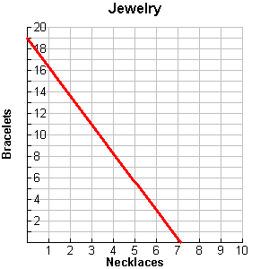
b. Graph the solutions.
Step 1 Since Ada cannot make a negative amount of jewelry, the system is graphed only in Quadrant I. Graph the boundary line . Use a solid line for ≤.
=

Slide 5
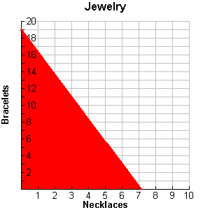
b. Graph the solutions.
Step 2 Shade below the line. Ada can only make whole numbers of jewelry. All points on or below the line with whole number coordinates are the different combinations of bracelets and necklaces that Ada can make.

Slide 6
c. Give two combinations of necklaces and bracelets that Ada could make.
Two different combinations of jewelry that Ada could make with 285 beads could be 2 necklaces and 8 bracelets or 5 necklaces and 3 bracelets.
(2, 8)
•
•
(5, 3)

Slide 7
What if…? Dirk is going to bring two types of olives to the Honor Society induction and can spend no more than $6. Green olives cost $2 per pound and black olives cost $2.50 per pound
a. Write a linear inequality to describe the situation.
b. Graph the solutions.
c. Give two combinations of olives that Dirk could buy.

Slide 8
Let x represent the number of pounds of green olives and let y represent the number of pounds of black olives.
Write an inequality. Use ≤ for “no more than.”
is no more than
Green
olives
black
olives
total
cost.
plus
2x
+
2.50y
≤
6
Solve the inequality for y.
2x + 2.50y ≤ 6
–2x –2x
Subtract 2x from both sides.
2.50y ≤ –2x + 6
2.50y ≤ –2x + 6
Divide both sides by 2.50.
2.50
2.50

Slide 9
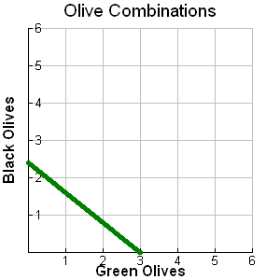
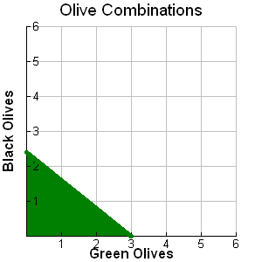
y ≤ –0.80x + 2.4
b. Graph the solutions.
Step 1 Since Dirk cannot buy negative amounts of olives, the system is graphed only in Quadrant I. Graph the boundary line for y = –0.80x + 2.4. Use a solid line for≤.
Step 2 Shade below the line.

Slide 10
c. Give two combinations of olives that Dirk could buy.
Two different combinations of olives that Dirk could purchase with $6 could be 1 pound of green olives and 1 pound of black olives or 0.5 pound of green olives and 2 pounds of black olives.
(0.5, 2)
•
(1, 1)
•

