Slide 1
Systems of inequalities
Solutions

Slide 2
Solutions Of A System Of Linear Inequalities: all the ordered pairs (infinite) that satisfy all the linear inequalities in the system.

Slide 3
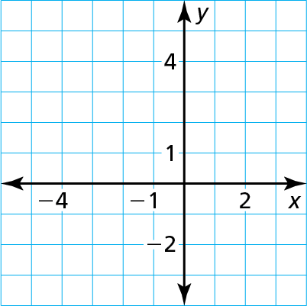
Identify a solution to the system.
y $≤$ 3
y $>$ x $+$ 2
$$Is \left(−3,1\right) a solution to the system?$$
Yes. The point is in the solution shaded region.
($−$3, 1)
$$Is the point \left(−1,1\right)a solution?$$
No. It is on the dashed boundary line of the solution.

Slide 4
Tell whether each ordered pair is a solution of the system of linear inequalities.
y $<$ 2x
Inequality 1
y $≥$ x $+$ 1
Inequality 2
(3, 5)
a. Substitute 3 for x and 5 for y in each inequality.
Inequality 1
Inequality 2
y $<$ 2x
y $≥$ x $+$ 1
?
?
5 $<$ 2(3)
5 $≥$ 3$+$ 1
5 $<$ 6
5 $≥$ 4
Because the ordered pair (3, 5) is a solution of each inequality, it is a solution of the system.

Slide 5
b. ($−$2, 0)
Substitute −2 for x and 0 for y in each inequality.
Inequality 1
Inequality 2
y $<$ 2x
y $≥$ x $+$ 1
?
?
0 $<$ 2($−$2)
0 $≥$ $−$2 $+$ 1
0 $≮$ $−$4
0 $≥$ $−$1
Because ($−$2, 0) is not a solution of both inequalities, it is not a solution of the system. It is
a solution to the second inequality, but not the first.

