Slide 1
Systems of Equations
Solving by graphing

Slide 2
Warm Up
Is the point a solution (on the graph) of the equation? Show your substitution and simplify.
2x - 3y = 6 (-2,-3)
$$NO$$
What is the slope and y-intercept of the line? Rewrite into slope-intercept form.
$$0=5x+5y$$
$$y=−x$$
$$m=−1 b=0 y−intercept (0,0)$$

Slide 3
system of linear equations : set of two or more linear equations containing two or more variables.
solution of a system of linear equations with two variables is an ordered pair that satisfies each equation in the system.

Slide 4
Methods for Solving systems of Equations
Graphing
Substitution
Elimination

Slide 5
Tell whether the ordered pair is a solution of the given system.
(5, 2);
3x – y = 13
3x – y = 13
0
Substitute 5 for x and 2 for y.
3(5) – 2 13
2 – 2 0
15 – 2 13
0 0
✓
13 13
✓
The ordered pair (5, 2) makes both equations true.
(5, 2) is the solution of the system.

Slide 6
Tell whether the ordered pair is a solution of the given system.
x + 3y = 4
(–2, 2);
–x + y = 2
x + 3y = 4
–x + y = 2
–2 + (3)2
4
Substitute –2 for x and 2 for y.
–(–2) + 2
2
–2 + 6 4
4 2
✗
4 4
✓
The ordered pair (–2, 2) makes one equation true, but
not the other. (–2, 2) is not a solution of the system.

Slide 7
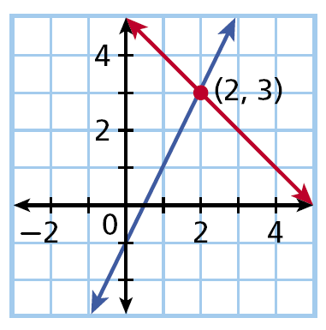
y = 2x – 1
y = –x + 5
The point (2, 3) is where the two lines intersect and is a solution of both equations, so (2, 3) is the solution of the systems.

Slide 8
Helpful Hint
Sometimes it is difficult to tell exactly where the lines cross when you solve by graphing. Check your answer by substituting it into both equations.

Slide 9
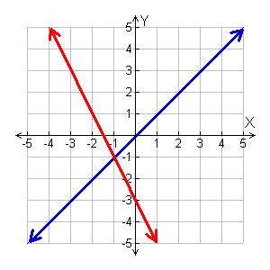
Solve the system by graphing. Check your answer.
y = x
Graph the system.
y = –2x – 3
The solution appears to be at (–1, –1).
Check
Substitute (–1, –1) into the system.
y = x
y = x
y = –2x – 3
(–1) (–1)
(–1) –2(–1) –3
•
✓
–1 –1
–1 2 – 3
✓
y = –2x – 3
–1 – 1
The solution is (–1, –1).

Slide 10
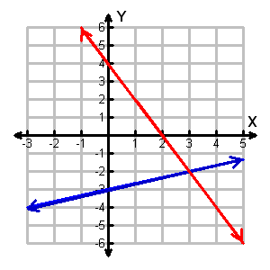
Solve the system by graphing. Check your answer.
Graph the system.
2x + y = 4
Rewrite the second equation in slope-intercept form.
y = –2x + 4
2x + y = 4
–2x – 2x
y = –2x + 4
The solution appears to be (3, –2).

Slide 11
Check It Out! Example 2b Continued
Solve the system by graphing. Check your answer.
2x + y = 4
Check Substitute (3, –2) into the system.
2x + y = 4
The solution is (3, –2).
2(3) + (–2) 4
–2 (3) – 3
6 – 2 4
–2 1 – 3
4 4
✓
–2 –2
✓

