Slide 1
Graphing linear review and solutions.

Slide 2
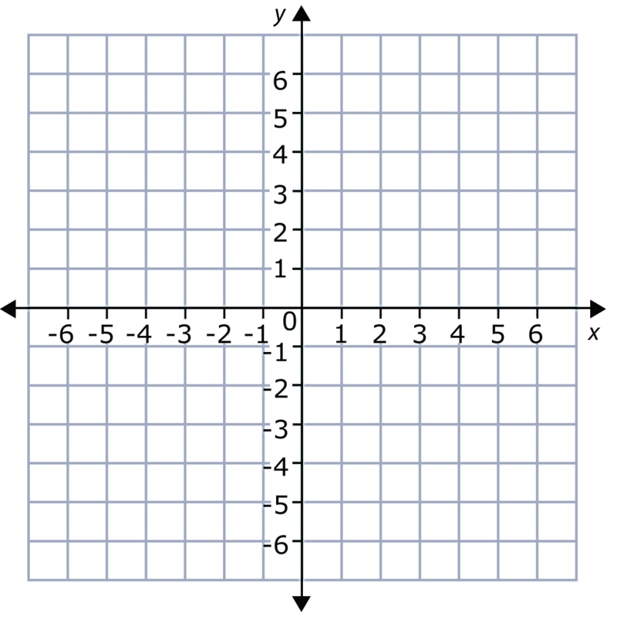
$$Graph y=−\frac{3}{2}x+4$$
Warm up
$$−\frac{3}{2}$$
$$m=$$
$$b=$$
$$4$$
$$y−intercept$$
$$(0,4)$$

Slide 4
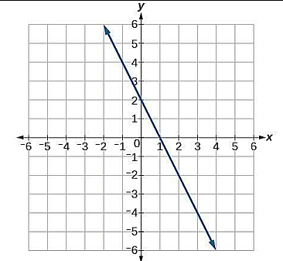
$$y=−2x+2$$
All points on the graph are solutions of the equation $y=−2x+2$
There are an infinite number of solutions.

Slide 5
Example
Determining Whether a Point is on a Graph (A SOLUTION)
Without graphing, tell whether each point is on the graph of 2x + 5y = 16.
(3, 2)
Substitute:
2x + 5y = 16
?
2(3) + 5(2) 16
=
?
6 + 10 16
=
16 = 16
✓
Since (3, 2) is a solution to 2x + 5y = 16, (3, 2) is on the graph.

Slide 6
Is the point is on the graph of the equation 2x + 5y = 16.
(-2, 2)
Substitute:
2x + 5y = 16
?
=
2(-2) + 5(2) 16
?
-4 + 10 16
=
6 ≠ 16
✗
Since (2, 2) is not a solution to 2x + 5y = 16, (2, 2) is not on the graph.

