Slide 1
Scientific Notation
Scientific notation is used as a way to state very large
numbers or very small numbers.

Slide 2
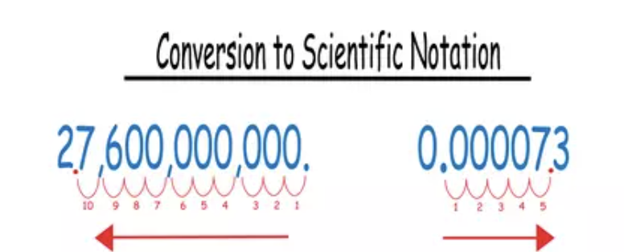
Standard Form Scientific Notation

Slide 4
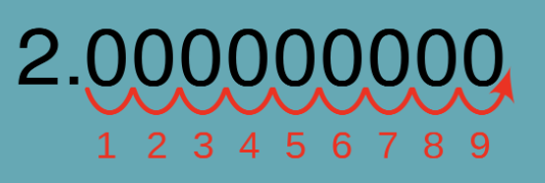

Slide 5
Multiplication with Scientific Notation
Light travels at about 1.86 × 10⁵ miles per second. Find the approximate distance that light travels in one hour. Write your answer in scientific notation.
distance = rate × time
Light will travel 6.696 × 10⁸ miles in one hour.

Slide 6
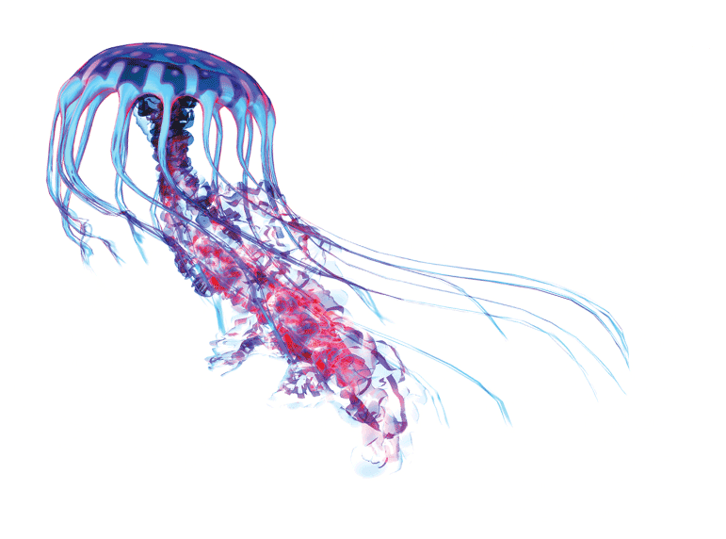
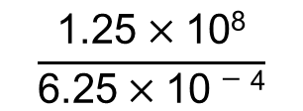
A jellyfish emits about 1.25 $×$ 10⁸ particles of light, or photons, in
6.25 $×$ 10$−$⁴ second. How many photons does the jellyfish emit each second?
Write your answer in scientific notation and in standard form.
Divide to find the unit rate in photons per second.
$$\frac{\text{1}\text{.25}×\text{10}\text{8}}{\text{6}\text{.25}×\text{1}\text{0}−\text{4}}$$
photons
Divide the number of photons by the number of seconds.
seconds
$$= \frac{\text{1.25}}{\text{6}\text{.25}} × \frac{\text{10}\text{8}}{\text{1}\text{0}−\text{4}}$$
Rewrite.
$=$ 0.2 $×$ 10¹²
Simplify.
$=$ 2 $×$ 10¹¹
Write in scientific notation.
The jellyfish emits 2 $×$ 10¹¹, or 200,000,000,000 photons per second.

