Slide 1
Radicals and absolute value

Slide 3
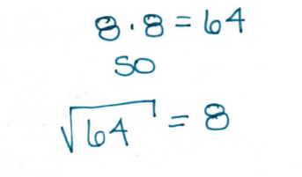

Slide 4
$$\sqrt{−16}$$
$$no real number$$
No number times itself (the same number) will equal -16.
$$\sqrt[3]{8}$$
$$2$$
$$2∙2∙2=8$$
$$\sqrt[3]{−8}$$
$$−2$$
$$a negative can be the radicand of a cube root.$$

