Slide 1
Exponent properties
Quotient Properties

Slide 2
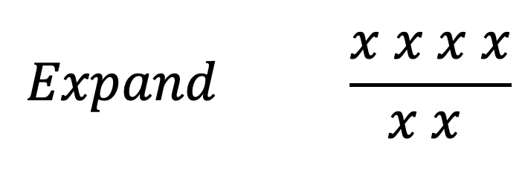
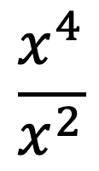
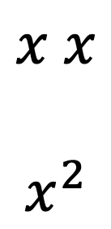
Quotient of Powers
$$\frac{x^{4}}{x^{2}}$$
$$Expand \frac{x x x x}{x x }$$
$$x x$$
$$x^{2}$$
$$4−2$$
$$Property: Subtract the exponents$$

Slide 3
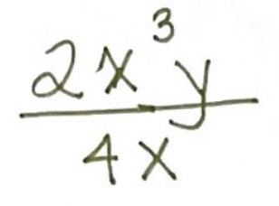
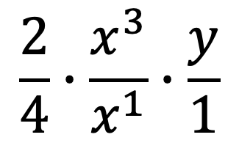
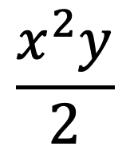
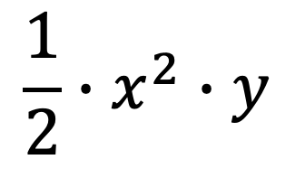
$$\frac{2}{4}∙\frac{x^{3}}{x^{1}}∙\frac{y}{1}$$
$$3−1$$
$$\frac{1}{2}∙x^{2}∙y$$
$$\frac{x^{2}y}{2}$$

Slide 4
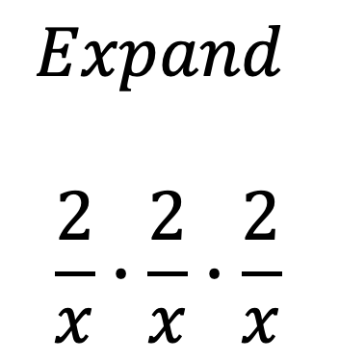
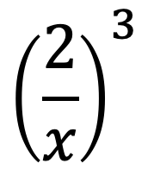
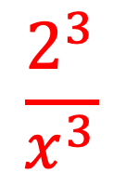
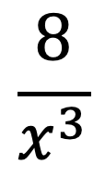
Power of a Quotient
$${\left(\frac{2}{x}\right)}^{3}$$
$$Property: Apply the exponent to the$$
$$numerator and denominator.$$
$$Expand$$
$$\frac{2}{x}∙\frac{2}{x}∙\frac{2}{x}$$
$$\frac{2^{3}}{x^{3}}$$
$$\frac{8}{x^{3}}$$

Slide 5
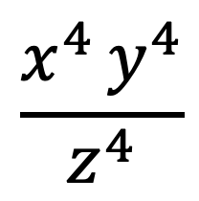
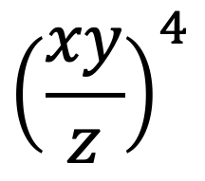
$${\left(\frac{xy}{z}\right)}^{4}$$
$$\frac{x^{4 }y^{4}}{z^{4}}$$

