Slide 1
Powers

Slide 2
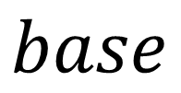
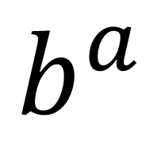
$$exponent$$
$$b^{a}$$
$$base$$

Slide 3
What is the base of the following powers?
$${−5}^{4}$$
$$5$$
$$z^{−3}$$
$$z$$
$$(x+2)²$$
$$(x+2)$$

Slide 4
Expanded form or product (multiplication)

Slide 5
