Slide 1
Inequalities
Plotting Solutions on the number line

Slide 2
Inequalities notation review
Inequality: a statement that two quantities are not equal.
Inequality symbols
$$< less than ≤ less than or equal to$$
$> greater than ≥ greater than or equal to$
solution of an inequality: any value that makes the inequality true.

Slide 3
When graphing inequalities, a filled circle indicates the number is included. An unfilled circle indicates the number is not included.
$$≤and ≥$$
$$<and >$$
Example: Graph each inequality.
Draw a solid circle at –3 because
-3 is included in the solution.
m ≤ –3
−3
Shade in all numbers less than –3 and draw an arrow pointing to the left.
–8
–6
–4
–2
0
2
4
6
8
10
12
Boundary point

Slide 4
compound inequality: When two simple inequalities are combined into one statement by the words AND or OR.

Slide 5
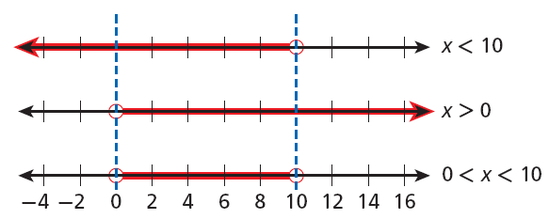
A compound inequality involving AND solution is an intersection. It shows the numbers that are solutions of both inequalities.

Slide 6
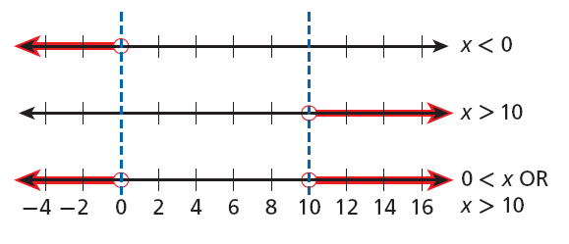
The graph of the solutions of a compound inequality involving OR is a union.
Union: the combined regions show the numbers that are solutions of either inequality.
>

