Slide 1
Multi-step inequalities

Slide 2
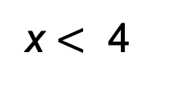
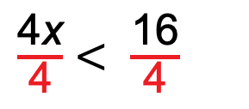
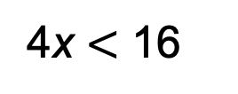
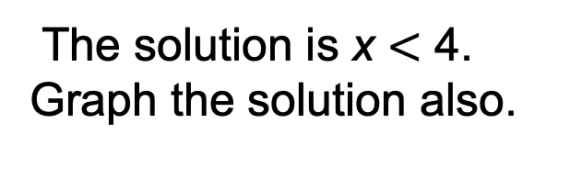
Solve 6x $−$ 5 $<$ 2x $+$ 11.
$+$ 5 $+$ 5
6x $<$ 2x $+$ 16
$−$ 2x $−$ 2x
4x $<$ 16
$\frac{\text{4}\text{x}}{\text{4}}$ $\text{<}$ $\frac{\text{16}}{\text{4}}$
x $<$ 4
The solution is x $<$ 4. Graph the solution also.

Slide 3
Solve the inequality and graph the solutions.
–4(2 – x) ≤ 8
−4(2 – x) ≤ 8
−4(2) − 4(−x) ≤
–8 + 4x ≤ 8
+8 +8
4x ≤ 16
x ≤ 4
The solution set is {x:x ≤ 4}.
–10
–8
–6
–4
–2
0
2
4
6
8
10

Slide 4
Solve the inequality and graph the solutions.
2(k – 3) > 6 + 3k – 3
Follow the same steps as solving an equation.
2(k – 3) > 3 + 3k
2k + 2(–3) > 3 + 3k
2k – 6 > 3 + 3k
–2k – 2k
–6 > 3 + k
–3 –3
–9 > k

Slide 5
Solve the inequality and graph the solutions.
2(k – 3) > 6 + 3k – 3
–9 > k
–12
–9
–6
–3
0
3
Always plug in a number and check your shading!!!!!!!!!!

Slide 6
All Real Numbers as Solutions
Solve the inequality.
2x – 7 ≤ 5 + 2x
Subtract 2x from both sides
$$−2x −2x$$
$$−7≤5$$
For any number 2x, subtracting 7 will always result in a lower number than adding 5.
All values of x make the inequality true.
All real numbers are solutions.

Slide 7
No Solutions
Solve the inequality.
Distribute 2 on the left side and 3 on the right side and combine like terms.
2(3y – 2) – 4 ≥ 3(2y + 7)
6y – 8 ≥ 6y + 21
$$−6y −6y$$
$$−8≥21 This is never true.$$
For any number 6y, subtracting 8 will never result in a higher number than adding 21.
No values of y make the inequality true.
There are no solutions. The solution set is ∅.

Slide 8
Lesson Quiz: Part II
4. Rick bought a photo printer and supplies for $186.90, which will allow him to print photos for $0.29 each. A photo store charges $0.55 to print each photo. How many photos must Rick print before his total cost is less than getting prints made at the photo store?
Rick must print more than 718 photos.

