Slide 1
What do solutions mean?
Solution of a system of linear equations is an ordered pair that makes both equations true. It is the point of intersection of the two lines.

Slide 2
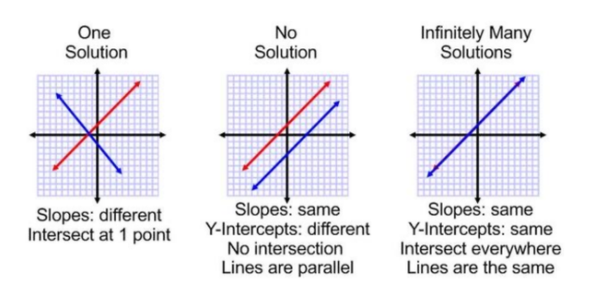
Can you think of a time that a system would not intersect or have more than one intersection?
Regardless of the method of solving, systems have these three possible outcomes.

Slide 3
y = x – 4
Solve
–x + y = 3
–x + (x – 4) = 3
Also notice
$$y=x−4$$
$$y=x+3$$
Both equations have the same slope. The lines are parallel and do not intersect.
–4 ≠ 3
✗
False statement. The equation has no solutions.
This system has no solution

Slide 4
y = x – 3
Solve
x – y – 3 = 0
Solve by substitution.
x – (x – 3) – 3 = 0
x –x + 3 – 3 =0
0=0
Infinite number of solutions.

Slide 5
y = x – 3
Solve
x – y – 3 = 0
Compare slopes and y-intercepts.
y = x – 3 y = 1x – 3
Write both equations in slope-intercept form. The lines have the same slope and the same y-intercept.
x – y – 3 = 0 y = 1x – 3
If this system were graphed, the graphs would be the same line. There are infinitely many solutions.

