Slide 1
Linear inequalities in two variables

Slide 2
Graphing Linear Inequalities in two variables
Step 1
Solve the inequality for y (slope-intercept form) if not already.
Graph the boundary line. Use a solid line for ≤ or ≥. Use a dashed line for < or >.
Step 2
Shade the half-plane above the line for y > or ≥. Shade the half-plane below the line for y < or y ≤. Check your answer.
Step 3

Slide 3
A solution of a linear inequality is any ordered pair that makes the inequality true.

Slide 4
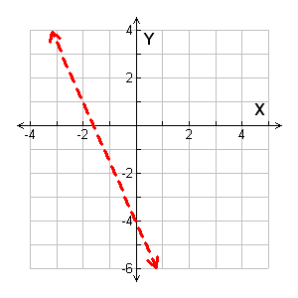
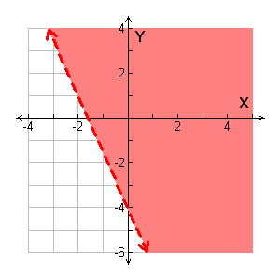
Graphing Linear Inequalities in Two Variables
5x + 2y > –8
5x + 2y > –8
–5x –5x
2y > –5x – 8
y > x – 4
$m=−\frac{5}{2}$ b= -4
Dashed boundary line. $>$
The inequality is >, so shade above the line.
Test a point to determine if you shaded correctly or to determine how to shade. (0,0)
You can not test (0,0) if your line passes through (0,0)
$$0≻\frac{5}{2} ∙0−4$$
$$0≻−4 true or false$$
True. Shade to cover the point (0,0)

Slide 5
All of the coordinate pairs, (points) in the shaded region are solutions to the inequality. Points on the dashed line are not solutions since the dashed line indicates $>not ≥.$
$$\left(2, 1\right)is a solution.$$
(0,-4) is not
(-3, -1) is not

Slide 6
Identifying Solutions of Inequalities
Tell whether the ordered pair is a solution of the inequality.
(–2, 4); y < 2x + 1
y < 2x + 1
4 2(–2) + 1
4 –4 + 1
✗
4 –3
<
(–2, 4) is not a solution.

Slide 7
Identifying Solutions of Inequalities
Tell whether the ordered pair is a solution of the inequality.
(3, 1); y > x – 4
y > x − 4
1 3 – 4
>
✓
1 – 1
(3, 1) is a solution.

