Slide 1
Fractional exponents

Slide 2
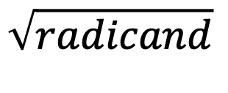
Index number
Radical
$$\sqrt{radicand}$$
3
$$\sqrt{radicand}$$
If there is no index number shown, it is a square root and the index number is 2.

Slide 4
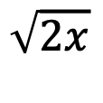
$$Write from radical form to exponential form$$
$$\sqrt[4]{x}$$
$$x^{\frac{1}{4}}$$
$$\sqrt{2x}$$
$${(2x) }^{\frac{1}{2}}$$
$$Write from exponential form to radical form$$
$${(xy)}^{\frac{1}{4}}$$
$$\sqrt[4]{xy}$$
$$3z^{\frac{1}{3}}$$
$$3\sqrt[3]{z}$$

