Slide 1
Exponential Functions

Slide 2
$$f\left(x\right)=a∙b^{x}$$
$$a: starting value$$
$$b:multiplier$$
$$b>1 exponential growth$$
$$0<b<1 exponential decay$$

Slide 3
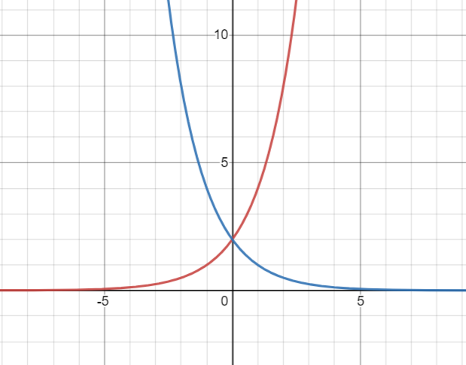
$$f\left(x\right)=2∙{\left(\frac{1}{2}\right)}^{x}$$
$$Decay$$
$$f\left(x\right)=2{∙(2)}^{x}$$
$$Growth$$
Asymptote $y=0$ This is the x axis.
$$Asymptote is the x axis$$
$$y=0 is the equation of the asymptote$$
Asymptote: A line that a graph approaches but does not touch.

Slide 4
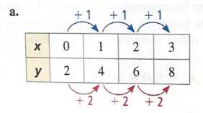
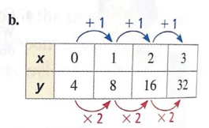
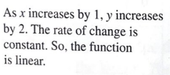

Slide 5
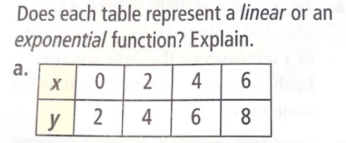
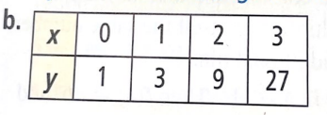
$$rate of change is 1$$

Slide 6
$$Evaluate f\left(x\right)=3({3)}^{x} for x=2$$
$$f\left(2\right)=3(3)²$$
$$f\left(2\right)=3∙9$$
$$f\left(2\right)=27$$

