Slide 1
Factoring Quadratics
$$ax^{2}+bx+c$$

Slide 2
Equivalent Forms
Forma factorizada
Multiplying
Formulario normalizado
Factored form
Standard form
Factoring
$$(x+2)(x+5)$$
$$x^{2}+7x+10$$
x²
ab
(x + a)(x + b) = x² + ax + bx + ab
ax
= x² + (a + b)x + ab
bx

Slide 3
Factoring Trinomials
Example 1
Factor x² + 15x + 36. Check your answer.
(x + )(x + )
El término constante en el trinomio es +36.
Multiply 36 $∙x²$
The constant term in the trinomial is +36.
$$36x²$$
$$3x$$
$$12x$$
List the Factors of 36 Sum of Factors
$$15x$$
36
18
12
9
6 6
37
20
15
13
12
Middle term
The product of positive 3 and 12 is 36 AND the sum of 3 and 12 is 15.
El producto de positivos 3 y 12 es 36 Y la suma de 3 y 12 es 15.
$$(x+3)(x+12)$$

Slide 4
Check your answer.
The factors of x² + 15x + 36 are (x + 3)(x + 12).
x² + 15x + 36 = (x + 3)(x + 12)
Check (x + 3)(x + 12)
= x² + 12x + 3x + 36
✓
= x² + 15x + 36

Slide 5
Example 2
Factor each trinomial. Check your answer.
x² + 10x + 24
(x + )(x + )
The constant term in the trinomial is +24.
Factors of 24 Sum of factors
$$24x²$$
24
12
8
6
25
14
11
10
$$4x$$
$$6x$$
$$10x$$
$$(x+4)(x+6)$$

Slide 6
Check your answer.
x² + 10x + 24
The factors of x² + 10x + 24 are (x + 4)(x + 6).
Check (x + 4)(x + 6)
= x² + 4x + 6x + 24
✓
= x² + 10x + 24

Slide 7
Example 3 Factoring x² + bx + c
When c is Positive and b is Negative
$$15x²$$
x² – 8x + 15
The factors of 15 need to be negative. The product is positive AND the sum is negative.
(x + )(x + )
$$−8x$$
Factors of 15 Sum
✗
Los factores de 15 deben ser negativos. El producto es positivo Y la suma es negativa.
–1 and –15 –16
✓
–3 and –5 –8
(x – 3)(x – 5)
Check (x – 3)(x – 5 ) = x² – 5x – 3x + 15
= x² – 8x + 15
✓

Slide 8
Example 4
Factor each trinomial. Check your answer.
x² – 5x + 6
b = –5 and c = 6; look for factors of +6 whose sum is –5.
(x + )(x+ )
b = –5 y c = 6; busque factores de +6 cuya suma sea –5.
Factors of 6 Sum
✗
–1 and –6 –7
✓
–2 and –3 –5
The factors needed are –2 and –3.
(x – 2)(x – 3)
Los factores necesarios son –2 y –3.
Check (x – 2)(x – 3) = x² – 3x – 2x + 6
✓
= x² – 5x + 6

Slide 9
When c is Negative and b is negative
Factor each trinomial.
One of the factors of 18 needs to be negative to have a product of -18.
x² – 3x – 18
(x + )(x + )
$$−18$$
Factors of –18 Sum
✗
1 and -18 –17
✗
2 and -9 – 7 -
3 and - 6 – 3
✓
$$−3$$
The factors needed are 3 and –6.
List the factors of 18. The larger numbers should be made negative so the sum is negative (-3)
(x – 6)(x + 3)

Slide 10
Example 6 Factor each trinomial. Check your answer.
x² + 2x – 15
(x + )(x + )
$$−15$$
Factors of –15 Sum
✗
–1 and 15 14
–3 and 5 2
✓
$$+2$$
(x – 3)(x + 5)
Check (x – 3)(x + 5) = x² + 5x – 3x – 15
✓
= x² + 2x – 15

Slide 11
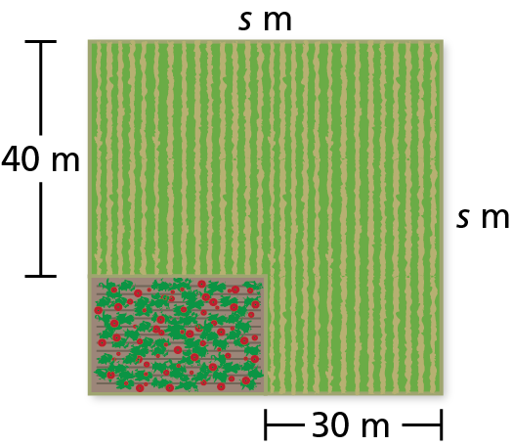
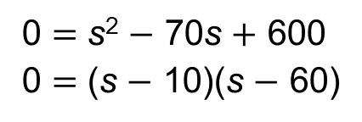
A farmer plants a rectangular strawberry patch in a corner of a square plot of land. The area of the strawberry patch is 600 square meters. FIND A QUADRATIC EQUATION IN STANDARD FORM
1. Understand the Problem You are given the area of a strawberry patch and a diagram showing dimensions of a plot of land that contains the strawberry patch. You are asked to find the total area of the plot of land.
2. Make a Plan The length of the strawberry patch is (s $−$ 30) meters and the width is (s $−$ 40) meters. Write and solve an equation to find the side length s. Then use the solution to find the area of the square plot of land.
600 $=$ (s $−$ 30)(s $−$ 40)
600 $=$ s² $−$ 70s $+$ 1200
Write an equation.
Multiply.
0 $=$ s² $−$ 70s $+$ 600
0 $=$ (s $−$ 10)(s $−$ 60)
Subtract 600 from each side.
Factor the polynomial.
$($ WIDTH )
s $=$ 10 or
s $=$60
$($ LENGTH )

Slide 12
Practice
Factor each trinomial. Check your answer.
x² + 8x – 20
(x + )(x + )
Product | Sum
-1 20 | 19
-2 10 | 8
-4 -5 | 1
$$(x−2)(x+10)$$

