Slide 1
Factoring
a>1

Slide 2
Factoring with a leading coefficient $≠1$
Factor 6x² + 11x + 4.
1. Multiply $6x^{2}and 4. Place the product at the top of the x shape$
1. Multiplica. $6x^{2}and 4$ Coloque el producto en la parte superior de la forma x
24x²
2. Place the middle term in the bottom of the x shape
3x
8x
2. Coloque el término medio en la parte inferior de la forma de x
3. Determine the factors of 24 that add to 11x
11x
24
12
8
6
3. Determina los factores de 24 que se suman a 11x
Pick the pair of factors that sum to 11x
$$4. Write the trinomial with the middle term split into two terms that were written$$
In the left and right of the x shape.
$$6x^{2}+3x+8x+4$$

Slide 3
$$6x^{2}+3x+8x+4$$
5. Factor by grouping Factor por agrupación
$$\left(6x^{2}+3x\right)+\left(8x+4\right)$$
$$3x\left(2x+1\right)+4\left(2x+1\right)$$
6. Factor out the GCF for each group.
6. Factorice el GCF para cada grupo.
(2x + 1)(3x + 4)
7. Factor out the (2x+1)
7. Factorice el (2x + 1)

Slide 4
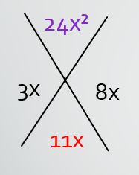
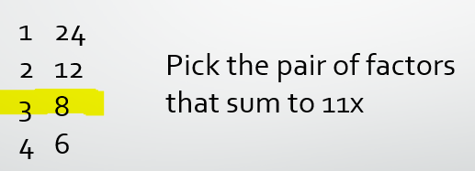
Complete the diamond as in the previous done.
6x² + 11x + 4
Completa el diamante como en el anterior hecho.
Write the terms in the generic rectangle.
$$2x$$
$$1$$
Escriba los términos en el rectángulo genérico.
$$3x$$
$$6x²$$
$$3x$$
$$4$$
$$8x$$
$$4$$
Factorice un GCF de la fila y la columna como en el paso 6 de la diapositiva anterior.
Factor out a GCF from the row and column as in step 6 on previous slide.

Slide 5
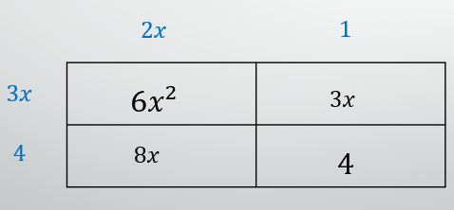
$$(3x+4)(2x+1)$$
Write the factors .
Escriba los factores .

Slide 6
Factor each trinomial. Check your answer.
5x² + 17x + 6
8x² + 27x + 9
(5x + 2)(x + 3)
(8x + 3)(x + 3)

Slide 7
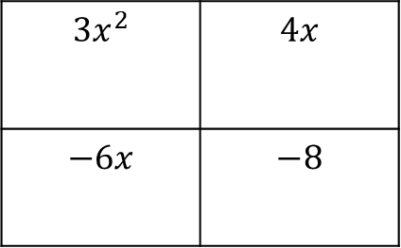
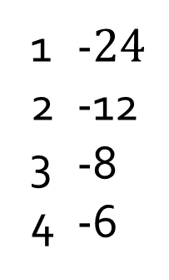
Factor each trinomial. Check your answer.
3x² – 2x – 8
$$−24x^{2}$$
-$24$
-12
-8
-6
$$−6x$$
$$4x$$
$$−2x$$
$$3x$$
$$4$$
$$3x^{2}$$ | $$4x$$
$$−6x$$ | $$−8$$
$$3x^{2}−6x+4x−8$$
$$x$$
$$3x\left(x−2\right)+4(x−2)$$
$$−2$$
✓
(x – 2)(3x + 4) = 3x² – 2x – 8

Slide 8
Factor. Check your answer.
2x² + 5x – 12
(2x – 3)(x + 4)

