Slide 1
Multiplying Polynomials
Binomials

Slide 2
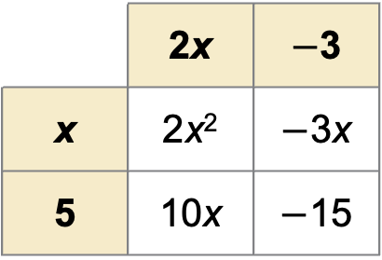
Find (2x $−$ 3)(x $+$ 5).
SOLUTION
Write each binomial as a sum of terms and make a table of products.
(2x $−$ 3)(x $+$ 5) $=$ [2x $+$ ($−$3)] (x $+$ 5)
 | 2x | $−$3
x | 2x² | $−$3x
5 | 10x | $−$15
The product is 2x² $−$ 3x $+$ 10x $−$ 15
2x² $+$ 7x $−$ 15.

