Slide 1
Polynomials

Slide 2
A monomial is a number, a variable, or a product of numbers and variables with whole-number exponents.
Un monomio es un número, una variable o un producto de números y variables con exponentes de números enteros.

Slide 3
The degree of a monomial is the sum of the exponents of the variables. A constant has degree 0.
El grado de un monomio es la suma de los exponentes de las variables. Una constante tiene grado 0.
$$4a^{4}b^{2}$$
$$degree is 6$$

Slide 5
Practice:
Write in standard form
Determine the degree of each term and overall degree
Determine the leading coefficient
y² + 4y⁶ – 3y
$$\text{4}\text{y}\text{6 }\text{+ }\text{y}\text{2 }\text{– 3}\text{y}$$
Degree
2
6
1
6
2
1
The degree of the polynomial is 6
El grado del polinomio es 6
The standard form is
4y⁶ + y² – 3y.
The leading
coefficient is 4.
El formulario estándar es
Los líderes
el coeficiente es 4.

Slide 6
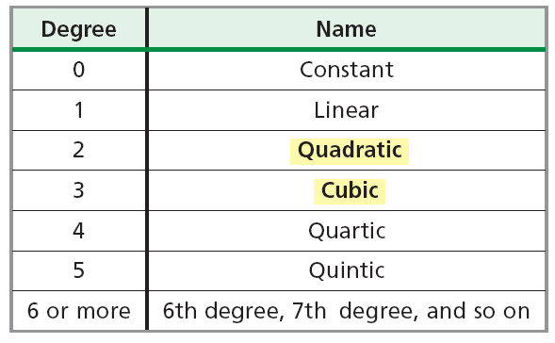
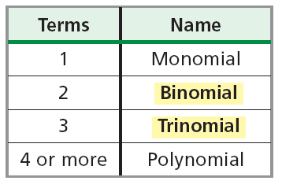
Some polynomials have special names based on their degree and the number of terms they have.

Slide 7

$$4x^{3}−7x$$
$$The Degree is$$
$$3$$
$$El Grado es$$
$$number of terms$$
$$2$$
$$number of termsnúmero de términos$$
$$name of polynomial by degree and number of terms$$
$$cubic binomial$$
$$nombre del polinomio por grado y número de términos$$

Slide 8
Classify each polynomial according to its degree and number of terms. Then write the name of the polynomial.
Clasificar cada polinomio según su grado y número de términos. Luego escriba el nombre del polinomio.
A. 5n³ + 4n
5n³ + 4n is a cubic binomial
Degree 3 Terms 2
B. –2x
Degree 1 Terms 1
–2x is a linear monomial

